Slide 1
Fourier Theory
Lecture 8
Half range expansions
Fourier integrals
Fourier cosine and Fourier sine transform
Fourier transform

Slide 2
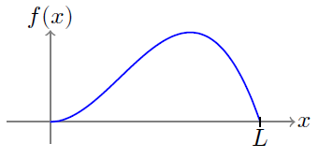
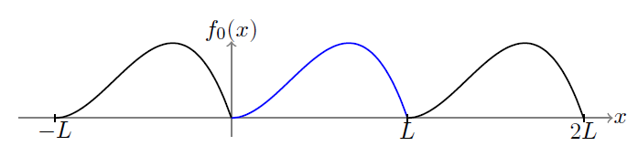
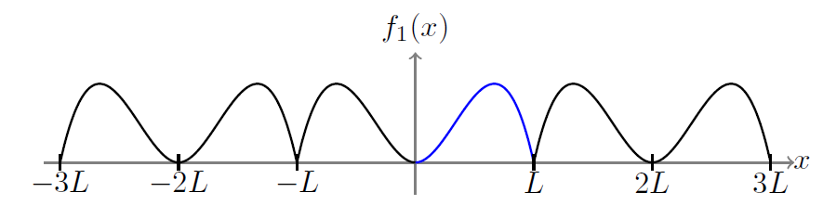
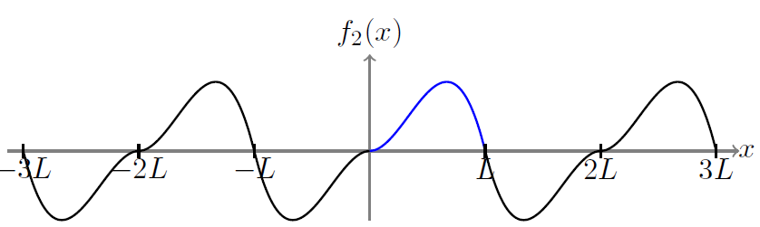
Half range expansions
Given a function: $f\left(x\right) 0<x<L$
J. Schmiegel: Lecture notes
We want to approximate $f\left(x\right)$ by means of Fourier series
i.e. $f\left(x\right)$ has to turn into a periodic function
There are 3 possibilities:
expansion
even expansion
odd expansion
J. Schmiegel: Lecture notes

Slide 3
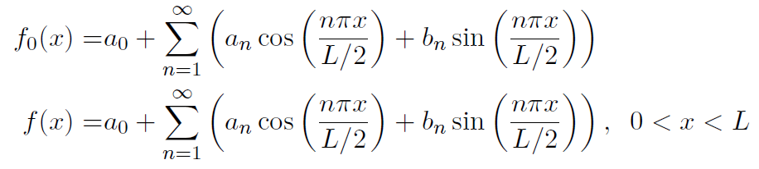
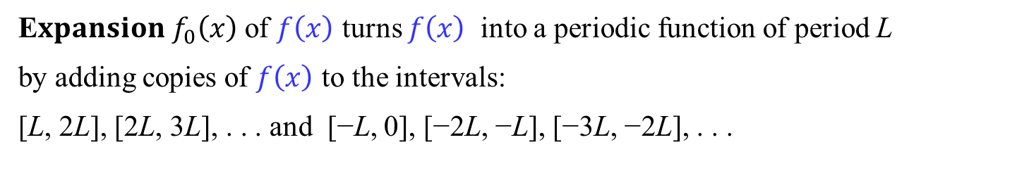
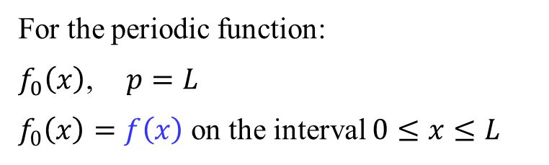
Expansion
E$xpansion f_{0}\left(x\right)$ of $f\left(x\right)$ turns $f\left(x\right)$ into a periodic function of period L
by adding copies of $f\left(x\right)$ to the intervals:
[L, 2L], [2L, 3L], . . . and [−L, 0], [−2L, −L], [−3L, −2L], . . .
For the periodic function:
$f_{0}\left(x\right)$, $p=L$
$f_{0}\left(x\right)=f\left(x\right)$ on the interval $0≤x≤L$
J. Schmiegel: Lecture notes
Fourier series representation:

Slide 4
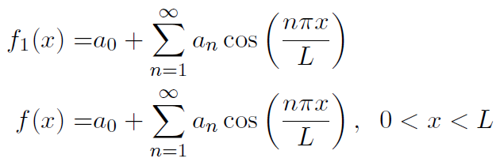
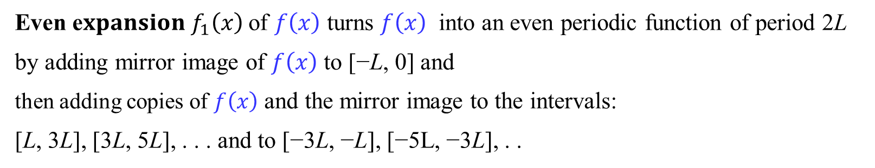
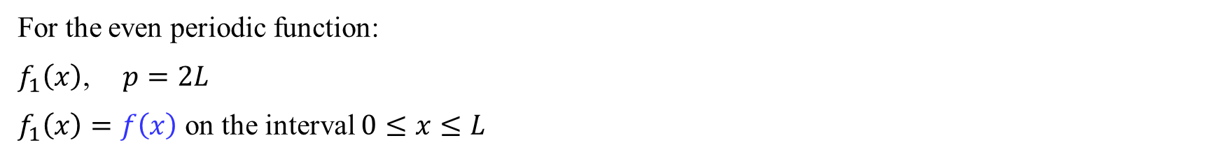
Even expansion
Even e$xpansion f_{1}\left(x\right)$ of $f\left(x\right)$ turns $f\left(x\right)$ into an even periodic function of period 2L
by adding mirror image of $f\left(x\right)$ to [−L, 0] and
then adding copies of $f\left(x\right)$ and the mirror image to the intervals:
[L, 3L], [3L, 5L], . . . and to [−3L, −L], [−5L, −3L], . .
For the even periodic function:
$f_{1}\left(x\right)$, $p=2L$
$f_{1}\left(x\right)=f\left(x\right)$ on the interval $0≤x≤L$
J. Schmiegel: Lecture notes
Fourier cosine series representation:

Slide 5
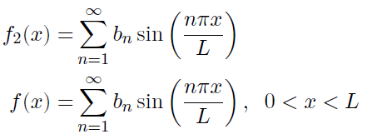
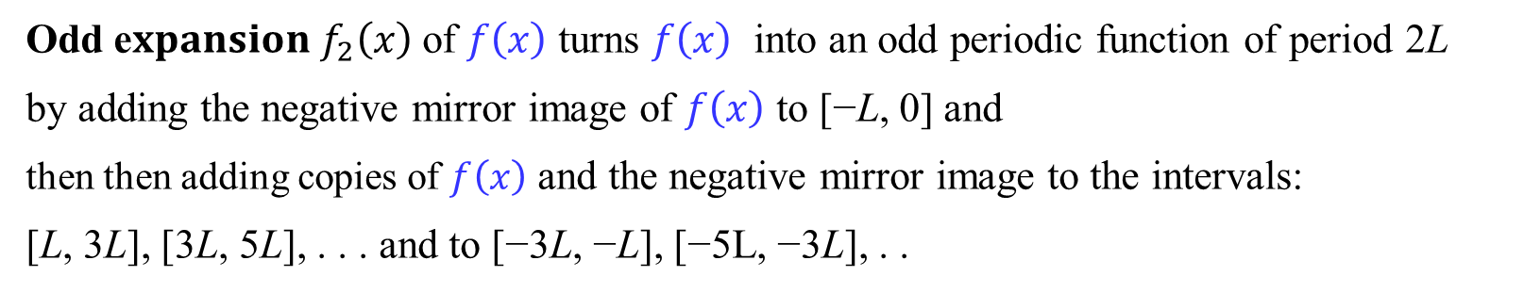

Odd expansion
Odd e$xpansion f_{2}\left(x\right)$ of $f\left(x\right)$ turns $f\left(x\right)$ into an odd periodic function of period 2L
by adding the negative mirror image of $f\left(x\right)$ to [−L, 0] and
then then adding copies of $f\left(x\right)$ and the negative mirror image to the intervals:
[L, 3L], [3L, 5L], . . . and to [−3L, −L], [−5L, −3L], . .
For the odd periodic function:
$f_{2}\left(x\right)$, $p=2L$
$f_{2}\left(x\right)=f\left(x\right)$ on the interval $0≤x≤L$
J. Schmiegel: Lecture notes
Fourier sine series representation:

Slide 6
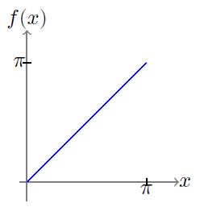
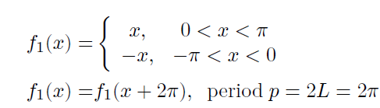
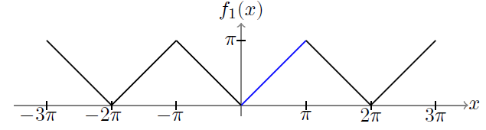
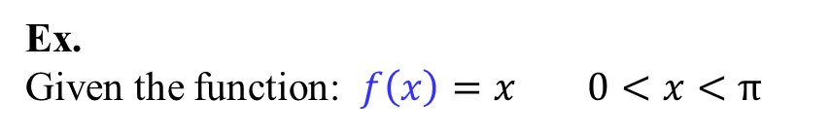

Even expansion
Ex.
Given the function: $f\left(x\right)=x 0<x<π$
J. Schmiegel: Lecture notes
The even expansion $f_{1}\left(x\right)$:
J. Schmiegel: Lecture notes

Slide 7
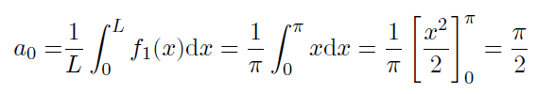
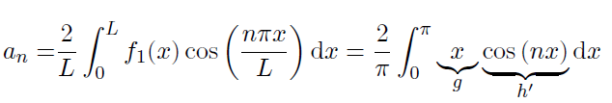
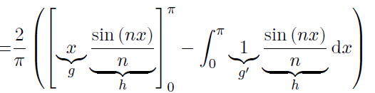
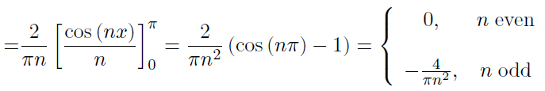
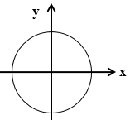
Even expansion
Ex. cont.
J. Schmiegel: Lecture notes

Slide 8

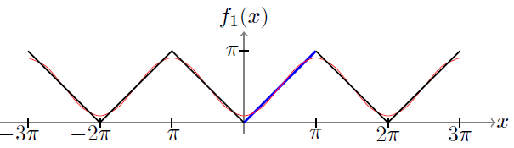
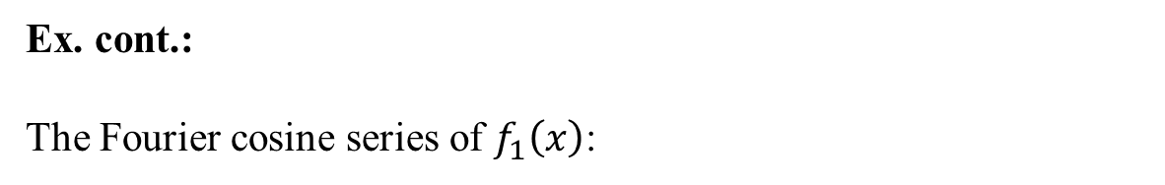
Even expansion
Ex. cont.:
The Fourier cosine series of $f_{1}\left(x\right)$:
J. Schmiegel: Lecture notes

Slide 9
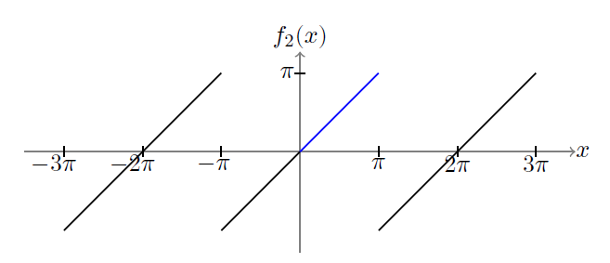

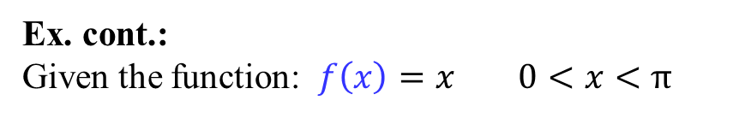

Odd expansion
Ex. cont.:
Given the function: $f\left(x\right)=x 0<x<π$
J. Schmiegel: Lecture notes
The odd expansion $f_{2}\left(x\right)$:
J. Schmiegel: Lecture notes

Slide 10

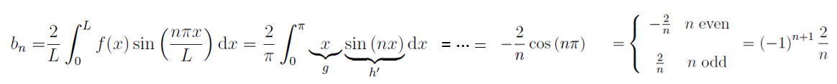

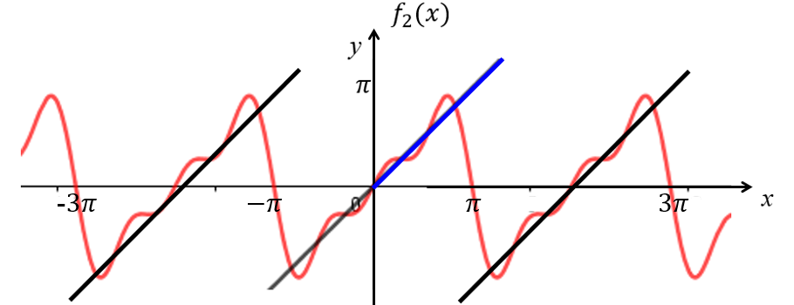
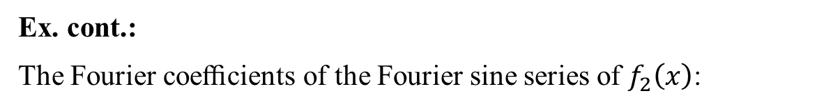
Odd expansion
Ex. cont.:
The Fourier coeﬃcients of the Fourier sine series of $f_{2}\left(x\right)$:
done in L7
The Fourier sine series of $f_{2}\left(x\right)$:

Slide 11



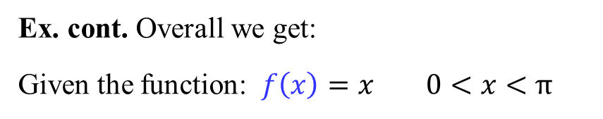
Even and odd expansion
Ex. cont. Overall we get:
Given the function: $f\left(x\right)=x 0<x<π$
The Fourier cosine series of $f\left(x\right)$
J. Schmiegel: Lecture notes
The Fourier sine series of $f\left(x\right)$:
Uniqueness: A given periodic function has only one Fourier series representation
$f\left(x\right)$is not periodic

Slide 12
Break?

Slide 13

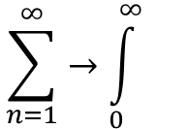



Fourier Integrals
Untill now we have considered Fourier series for periodic functions and for functions defined on a finite interval.
Now we turn to arbitrary functions that are not periodic and defined on the whole x-axis, i.e. $−∞<x<∞$.
What happens if $L→∞$?
Basic interval: $\left[−L,L\right]$
$∆ω=ω_{n+1}−ω_{n}=\frac{\left(n+1\right)π}{L}−\frac{nπ}{L}=\frac{π}{L}→0$ for $L→∞$
J. Schmiegel: Lecture notes
$$\sum_{n=1}^{∞}{→\int_{0}^{∞}{}}$$

Slide 14






Fourier Integrals
Let f(x) be a piecewise continuous function and assume that
the left–hand limits, the right–hand limits, the left–hand derivative and the right–hand derivative exist
and the integral exists, i.e. is finite
The Fourier integral representation of f(x):
and at points $x_{0}$ where f(x) is not continuous:
Fourier coeﬃcients are given as: and

Slide 15
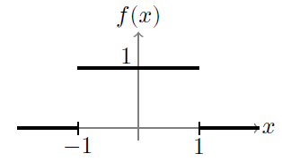



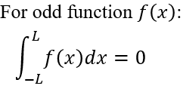
Fourier Integrals
Ex.:
Given the function:
J. Schmiegel: Lecture notes
Check the absolute integrability:
The Fourier coefficients are:
The Fourier integral representation:

Slide 16

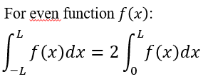



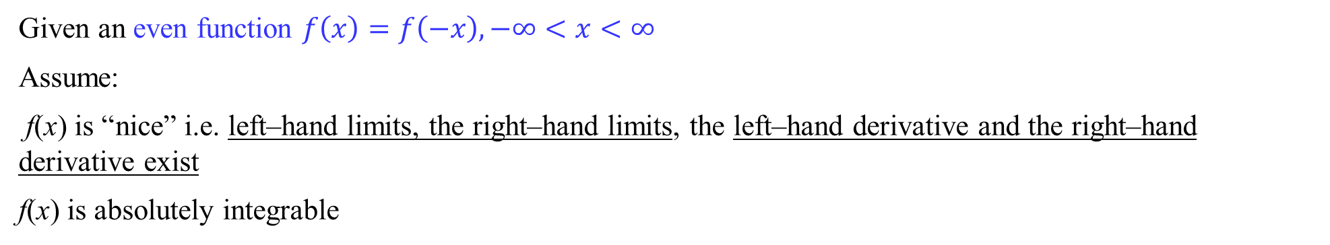
Fourier cosine integrals
Given an even function $f\left(x\right)=f\left(−x\right), −∞<x<∞$
Assume:
f(x) is “nice” i.e. left–hand limits, the right–hand limits, the left–hand derivative and the right–hand derivative exist
f(x) is absolutely integrable
The Fourier coeﬃcients are:
The Fourier cosine integral:

Slide 17


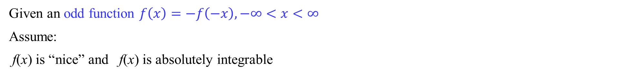
Fourier sine integrals
Given an odd function $f\left(x\right)=−f\left(−x\right), −∞<x<∞$
Assume:
f(x) is “nice” and f(x) is absolutely integrable
The Fourier coeﬃcients are:
The Fourier sine integral:

Slide 18
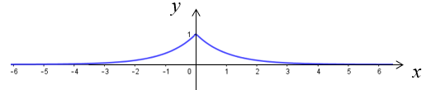



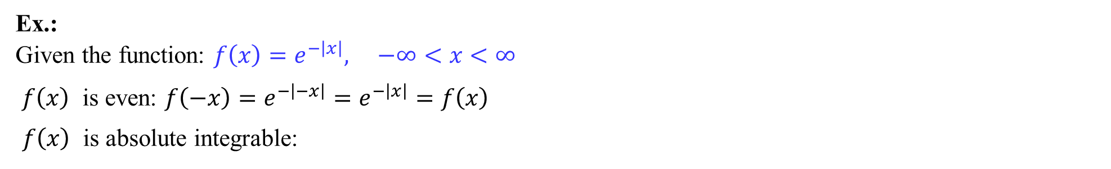
Fourier integrals
Ex.:
Given the function: $f\left(x\right)=e^{−\left|x\right|}, −∞<x<∞$
$f\left(x\right)$ is even: $f\left(−x\right)=e^{−\left|−x\right|}=e^{−\left|x\right|}=f\left(x\right)$
$f\left(x\right)$ is absolute integrable:
finite
The Fourier coeﬃcients are:
The Fourier cosine integral:

Slide 19
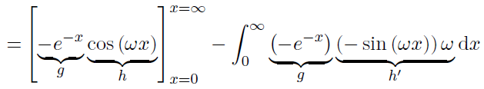


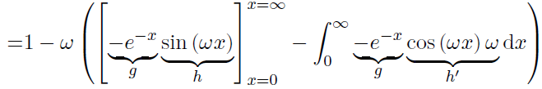


Fourier integrals
Ex. cont.:
Calculating I:
Then we have:
The Fourier coeﬃcients are:

Slide 20
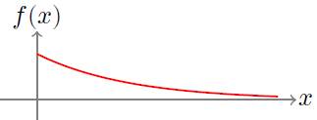
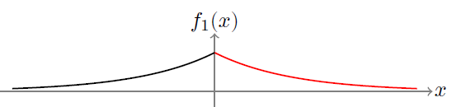
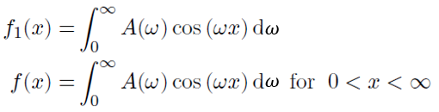

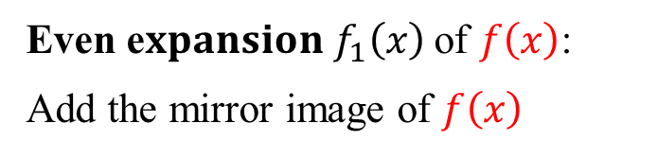
Fourier integral - even expansion
Given “nice” function: $f\left(x\right), 0<x<∞$ (or $−∞ <x<0$)
Even e$xpansion f_{1}\left(x\right)$ of $f\left(x\right)$:
Add the mirror image of $f\left(x\right)$
J. Schmiegel: Lecture notes
A “nice” function defined on $0<x<∞$ (or $−∞ <x<0$) has a Fourier cosine integral representation

Slide 21
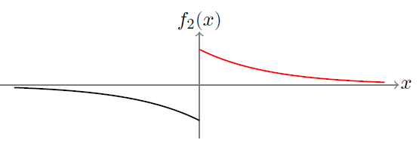
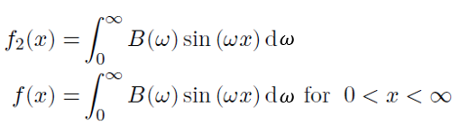

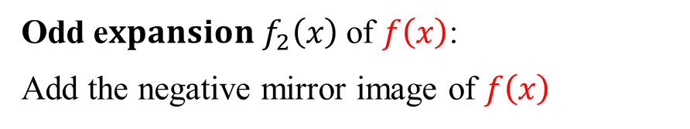
Fourier integral - odd expansion
Given nice function: $f\left(x\right), 0<x<∞$ (or $−∞ <x<0$)
Odd e$xpansion f_{2}\left(x\right)$ of $f\left(x\right)$:
Add the negative mirror image of $f\left(x\right)$
J. Schmiegel: Lecture notes
A “nice” function defined on $0<x<∞$ (or $−∞ <x<0$) has a Fourier sine integral representation

Slide 22

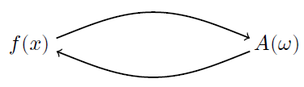



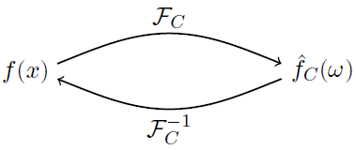
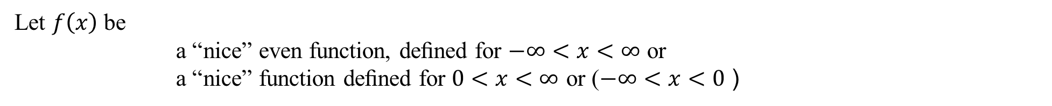

Fourier cosine transform
Let $f\left(x\right)$ be
a “nice” even function, deﬁned for $−∞<x<∞$ or
a “nice” function deﬁned for $0<x<∞$ or ($−∞<x<0$ )
The Fourier cosine integral:
J. Schmiegel: Lecture notes
The Fourier coeﬃcient:
The Fourier cosine transform of $f\left(x\right):$
The inverse Fourier cosine transform:
J. Schmiegel: Lecture notes

Slide 23





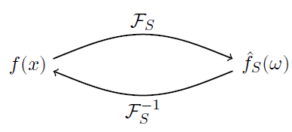


Fourier sine transform
Let $f\left(x\right)$ be
a “nice” odd function, deﬁned for $−∞<x<∞$ or
a “nice” function deﬁned for $0<x<∞$ or ($−∞<x<0$ )
The Fourier sine integral:
J. Schmiegel: Lecture notes
The Fourier coeﬃcient:
The Fourier sine transform of $f\left(x\right):$
The inverse Fourier sine transform:
J. Schmiegel: Lecture notes

Slide 24


Fourier cosine and Fourier sine transform - Properties
Let $f\left(x\right)$ and $g\left(x\right)$ be “nice” functions (assuming that Fourier transforms exist) and let a and b be constants
Linearity:
The Fourier cosine transform $ℱ_{C}$ and the Fourier sine transform $ℱ_{S}$ are linear transformations.

Slide 25

Fourier cosine and Fourier sine transform - Properties
Let $f\left(x\right)$ be a “nice” function (assuming that Fourier transforms exist)
$$f\left(x\right)→0 for x→∞$$
Derivatives:
$f^{′}$denotes the ﬁrst derivative and $f^{′′}$denotes the second derivative

Slide 26




Fourier transform
Let $f\left(x\right)$ be a “nice” function, deﬁned for $−∞<x<∞$
The Fourier integral:
The Fourier coeﬃcients:
J. Schmiegel: Lecture notes

Slide 27




Fourier transform
Let $f\left(x\right)$ be a “nice” function, deﬁned for $−∞<x<∞$
The Fourier transform of $f\left(x\right):$
The inverse Fourier transform:
J. Schmiegel: Lecture notes

Slide 28


Fourier transform - Properties
Let $f\left(x\right)$ and $g\left(x\right)$ be “nice” functions (assuming that Fourier transforms exist) and let a and b be constants
Linearity:
Derivatives:
$f^{′}$denotes the ﬁrst derivative and $f^{′′}$denotes the second derivative

Slide 29



We are doing exercises from lecture notes 8
Exercise 4: Euler formulas:
$$e^{iωx}=\cos\left(ωx\right)+isin⁡(ωx)$$
$$e^{−iωx}=\cos\left(ωx\right)−isin⁡(ωx)$$

